Slide 1
Santiago Island 2023 Load Method
RE100 input pack update with Electricity Maps national-shape caveat
Annual anchor: 263.834916 GWh
Reconstructed peak: 42.039 MW
Average load: 30.118 MW
Load factor: 71.64%
Purpose: prepare inputs for Prof. Hohmeyer's existing hourly RE100 Excel model.
This package does not create a new model and does not modify model formulas.
The Santiago hourly load curve is reconstructed, not raw utility SCADA data.
Santiago RE100 input pack | Generated evidence package | Not official hourly SCADA data

Slide 2
DTU Santiago Load Reconstruction
Santiago-specific DTU shape scaled to Electra's official 2023 annual total
Source shape: DTU Cape Verde Reference System, `SantiagoData_v4.xlsx`, sheet `Equivalent Week Profile Load`.
Mapping: equivalent_day = (month - 1) * 7 + weekday_number, with Monday = 1 and Sunday = 7.
Scaling: load_mw = profile_value / annual_profile_sum * 263,839.489 MWh.
Annual total accuracy: 100% against the Electra 2023 Santiago annual production anchor by construction.
Hour-by-hour measured accuracy cannot be certified without Electra/EDEC's real 8760-hour meter record.
Santiago RE100 input pack | Generated evidence package | Not official hourly SCADA data

Slide 3
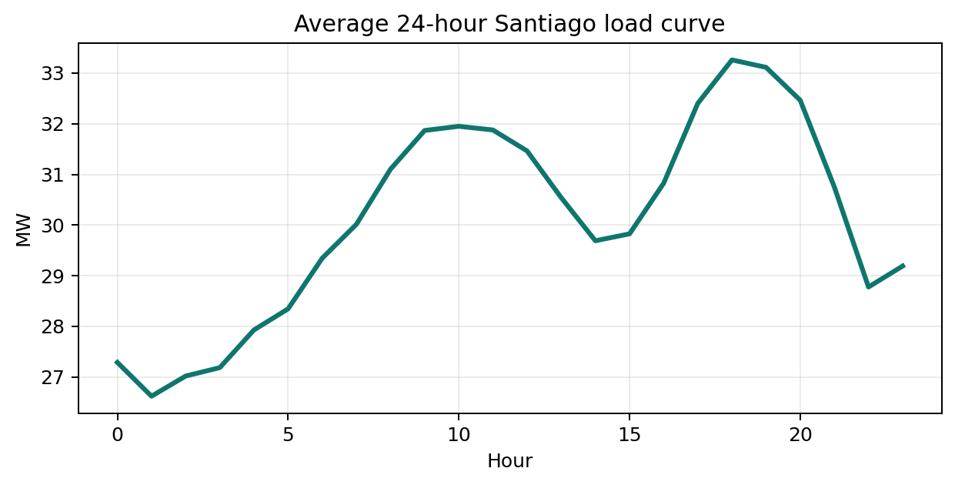
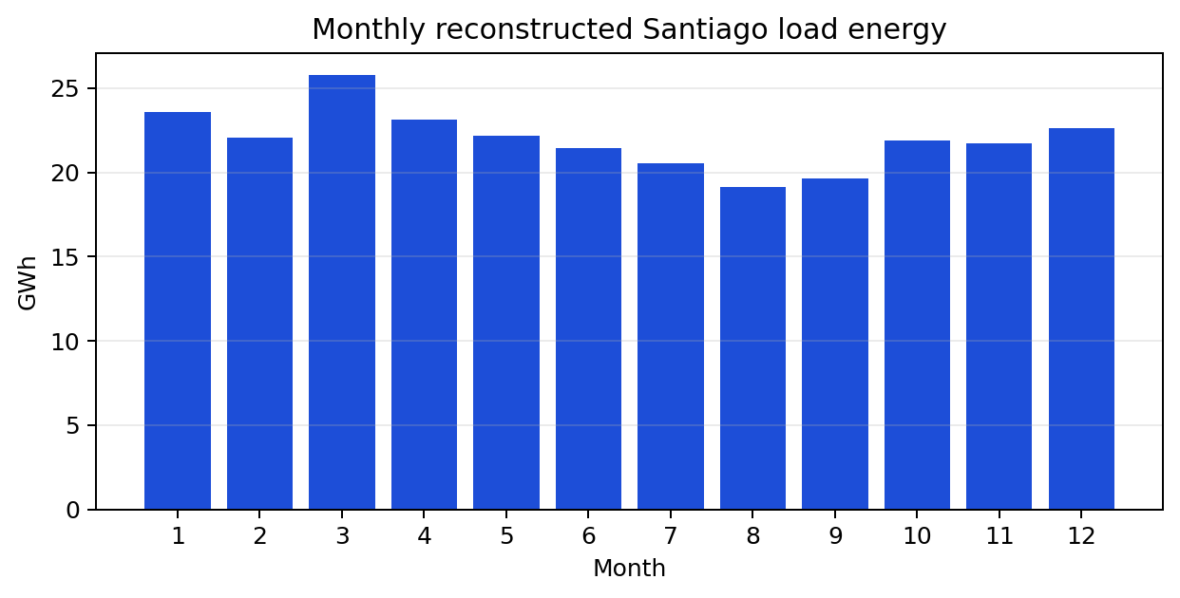
Load Evidence Charts
Reconstructed Santiago hourly-load summaries used for the RE100 input vector
Santiago RE100 input pack | Generated evidence package | Not official hourly SCADA data

Slide 4
Electricity Maps Check
Useful national benchmark, not Santiago truth
Electricity Maps reports Cabo Verde as national zone `CV`, not Santiago Island specifically.
The CV zone is Tier C in Electricity Maps documentation, so hourly values may be modelled from lower-frequency data.
Use case: national timing-shape benchmark and sensitivity check only.
Non-use case: do not replace the Santiago DTU profile and do not claim official Santiago hourly meter accuracy.
In the generated RE100 pack, no Electricity Maps CSV/token was available locally, so download was skipped and documented.
Santiago RE100 input pack | Generated evidence package | Not official hourly SCADA data

Slide 5
How Files Connect to the RE100 Workbook
Inputs are prepared for the professor's existing model structure
Hourly load vector: `Hourly Load!F7:F8766`, 8760 values in MWh/h, equivalent to MW for a one-hour step.
Wind vector: `Wind and Solar Input!D5:D8764`, 8760 hourly wind-speed values.
Solar vector: `Wind and Solar Input!E5:E8764`, 8760 hourly total solar-radiation values in kW/m2.
Scenario inputs: yellow cells in `Input & Output`, documented in the audit workbook.
Generated audit workbook tracks target cell/range, unit, value, source, confidence class, and explanation.
Santiago RE100 input pack | Generated evidence package | Not official hourly SCADA data

Slide 6
Confidence and Sharing Boundary
The package separates official facts, reconstructed data, and assumptions
A/B: official annual and peak values from Electra, with clear transformations where needed.
C: DTU Santiago profile and public reanalysis weather inputs.
D: scenario capacities, storage choices, and generic technical/economic model defaults.
The filled professor workbook was generated locally but is not redistributed here unless sharing permission is confirmed.
Open `Santiago_RE100_Input_Audit.xlsx` first for the defensibility trail.
Santiago RE100 input pack | Generated evidence package | Not official hourly SCADA data

